Slide 1
OVERHEAD ALLIANCE Lecture Material
Objective: This lecture material can be used to increase awareness of the overhead material handling industry and its products. The target audience is any academic who wants to integrate this material into their course work. Click here for information on the Overhead Alliance itself or on the logos below at any time for information on particular member groups.

Slide 2
Overhead equipment
When choosing a lifting and moving solution for a facility, consider an overhead hoist, crane or monorail. Overhead lifting solutions can improve efficiency, productivity and safety, and reduce environmental impact. New technology has made overhead lifting solutions easier and more productive to use than ever before. Advancements include enhanced precision controls and longer lasting equipment.

Slide 3
Basic choices for MH
 | Solutions
Application | Floor-mounted | Overhead
Fixed-path/ continuous use | Conveyors | Monorails
Variable path/ intermittent use | Industrial trucks | Cranes & hoists

Slide 4
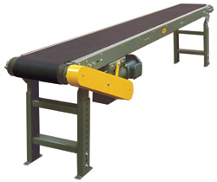
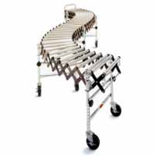
Conveyors
Commonly used for moving uniform loads continuously from point to point over fixed paths. Common types:
Powered - continuous belt, split belt, trolley, chain, rollers, etc.
Gravity - skate wheels, chutes, slides, rollers, etc.

Slide 5
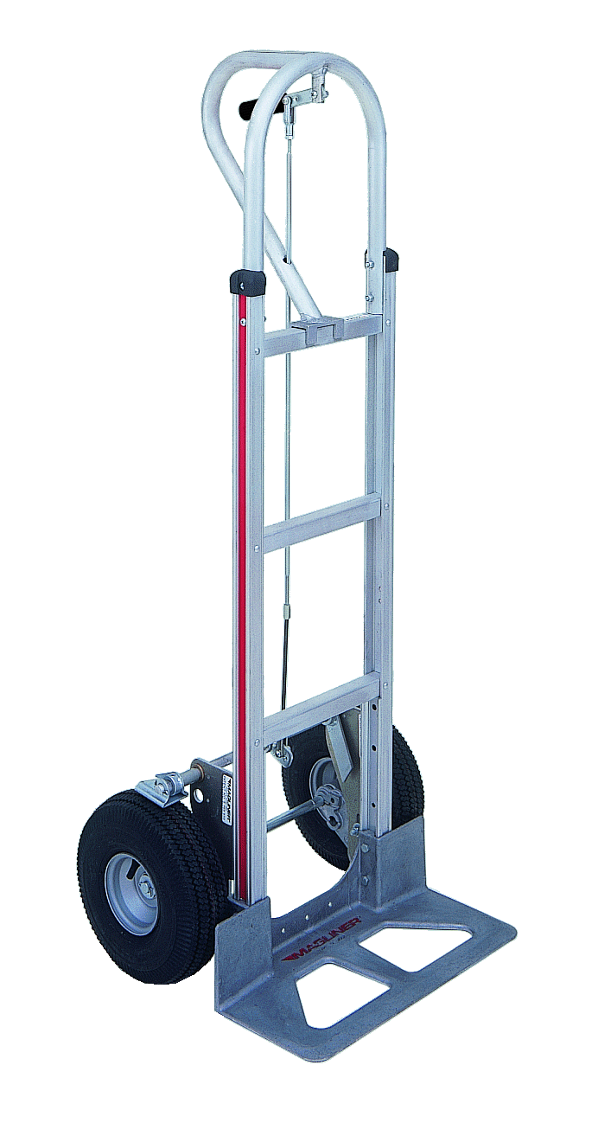
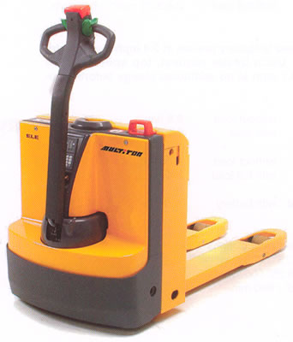
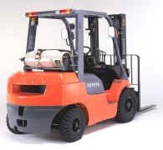
Industrial trucks
Used for lifting and/or moving loads intermittently over variable paths. Three main categories:
hand trucks
“walkies”
riding trucks
Automatic guided vehicles (AGVs) are essentially computer-guided and controlled riding trucks.

Slide 6
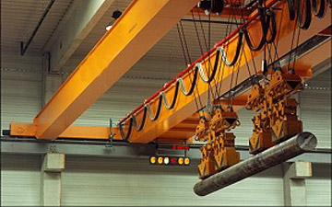
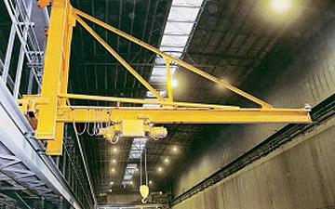
Overhead Cranes
Overhead Cranes lift and move material using a hoist, magnet, or other device to place a load at any point within its range. Common types such as a bridge or gantry crane allow three axes of hook motion. A jib crane can operate with 360⁰ rotation.

Slide 7
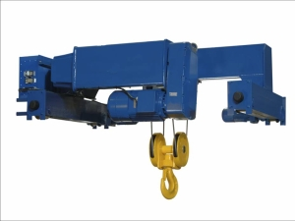
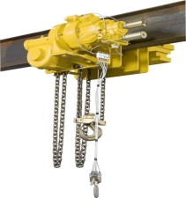
Overhead Hoists
Overhead Hoists are machinery units that are used for vertical lifting service involving material handling of freely suspended (unguided) loads. Overhead hoists are a basic and versatile piece of equipment used in manufacturing, warehousing, construction, and numerous applications to aid workers in the handling and moving of loads. Lifting mediums include wire rope or chain. Operation types include manual, electric, or air power.

Slide 8
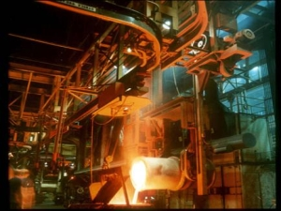
Monorails
Monorails are a single overhead track or track network used for lifting and transporting product on a fixed path. One or a group of carriers (powered or manually operated) move along the track. Monorail systems can provide coverage over almost any distance and are installed in the
building roof structure with the benefit of open floor space. Monorails allow access to hard-to-reach areas; they are a perfect solution for repetitive production processes or movement of product throughout one facility or multiple buildings. Monorails can be fixed, or part of a workstation crane system allowing for positioning of the monorail above product.

Slide 9
Advantages of overhead equipment
Compared to floor-mounted equipment, overhead lifting systems can increase safety, productivity, efficiency, and value for a facility, as well as improving environmental impact aspects.

Slide 10
Safety
Overhead Lifting Systems work within a specific area and limit an employee’s exposure to potential accidents caused by dangers like forklift traffic.
According to the National Institute for Occupational Safety and Health (NIOSH), back injuries cost American industry $10-14 billion in workers’ compensation costs and about 100 million work days annually. In the past, light loads were lifted manually, contributing to the statistics of on the job injury. Whether handling 50 pounds or 50 tons, installing a lifting and moving solution that limits the amount of manual handling by employees can help prevent physical injury.

Slide 11
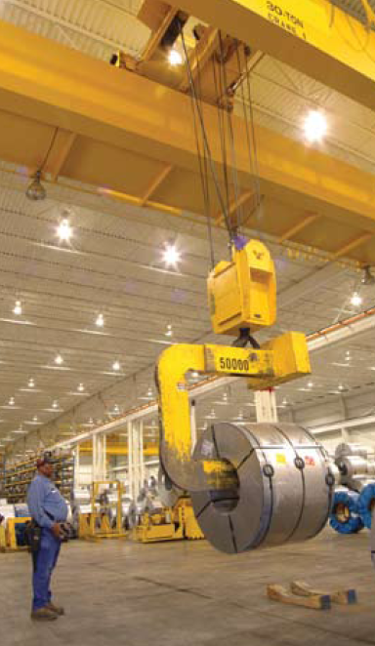
Safety
Radio remote controls and independent traveling pushbutton pendants allow for the operator of Overhead Lifting Solutions to stand away from the load. This means that the operator is further removed from danger. This reduces the risk of injury, and allows for a better view. This limits the risk of accidentally maneuvering the load into other workers in the area, walls, machinery, or obstacles.

Slide 12
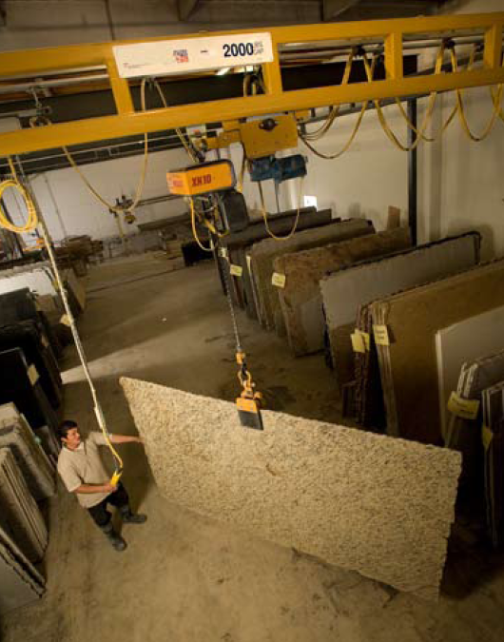
Productivity
Overhead Lifting Solutions minimize product handling and operator error. They allow for smooth direct-path transportation over obstacles with soft start features and multiple speed options for optimum control. There are a variety of below-the-hook devices and customized cranes, monorails, and hoists available for any application.
Product damage results in wasted materials, and it’s almost inevitable that some products with minor damage still make it to customers. Overhead Lifting Systems protect your products by self-centering loads. Compared to floor-based solutions, Overhead Lifting decreases the chance of damaging walls and structural supports or overturning.

Slide 13
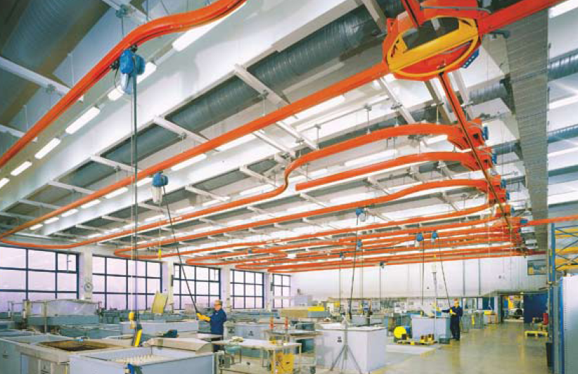
Efficiency
Overhead Lifting Solutions allow the user to take product up and over obstacles, instead of navigating back and forth through aisles. Straight lines are more efficient than roundabout paths to get from one point to another.
Overhead Lifting Solutions allow for greater lifting height, vertical storage, and more efficient use of space than floor-based units.

Slide 14
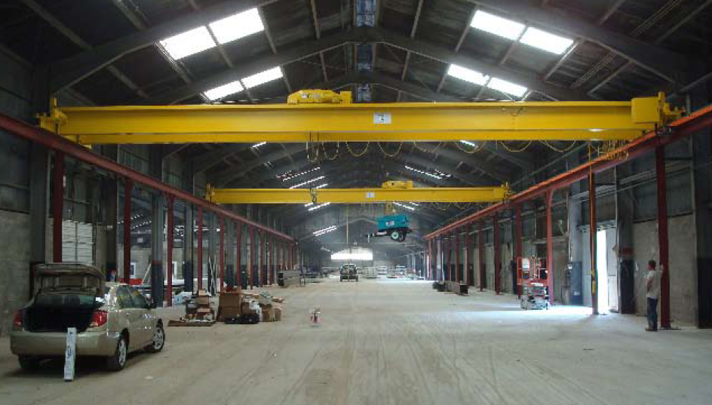
Value
Overhead Lifting Solutions can accommodate overhead or floor obstructions, and multiple workstations may be covered with one system.
Overhead Lifting Solutions are flexible by their very nature, and can easily be re-configured or converted and adapted to fit your changing needs, increasing the value of the facility.

Slide 15
Environment
The limitations of other lifting and moving choices often force business owners to seek new storage space for their facility, or for battery charge terminals. This need creates a domino effect of events detrimental to the environment.
Lifting systems powered the produce emissions can have numerous adverse effects on business, the environment, and employee health. These lifting and moving systems can produce air pollution through emissions as well as ground pollution through daily leakage.
Also consider the possible regulations and costs imposed on operations due to these harmful contaminants. Evaluation of building ventilation, regular emissions testing, and investment in contaminant detection equipment are just a few examples.

Slide 16
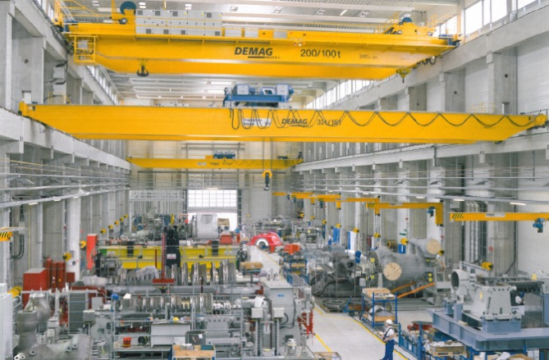
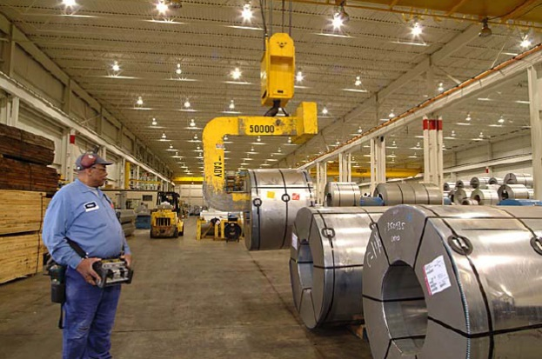
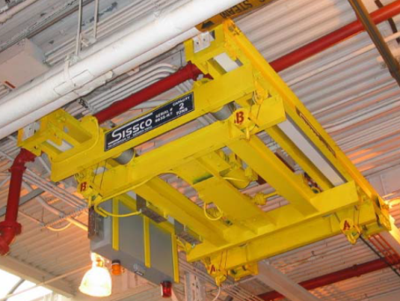
Selected case studies - Cranes
Cranes provide solution for major manufacturer of steam turbines
ASRS crane facilitates enzyme blending and storage for biofuel manufacturers
Gantry simplifies loading of large concrete panels
Custom hoists for railroad car maintenance
Coke-handling crane increases productivity and reduces downtime
Improved remote controls solve service center problems
Cranes service hydoelectric plant
Wall-mounted jibs provide supplemental lifting for crane manufacturer
Bridge crane with precise hook positioning lifts jet engines

Slide 17
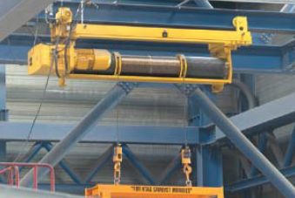
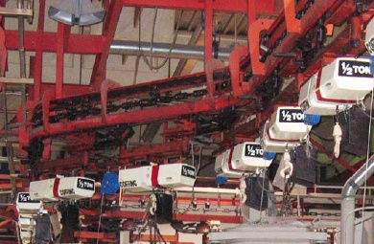
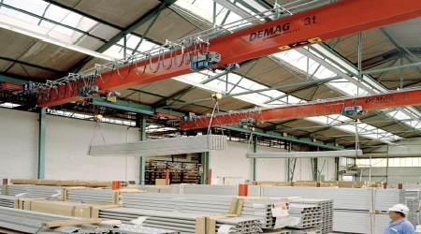
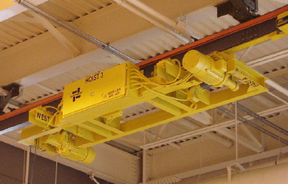
Selected case studies - Hoists
Unique rail system allows quick hoist exchange
University-Industry partnership studies auto worker ergonomic situation
Heavy duty electric chain hoist operates over hot sulfuric acid
Power station long lift wire rope hoist
Vertical roller mill maintenance hoists lift up to 200 tons
Hoist maintenance program reduces downtime
Crane and hoist efficiently load metal press
Hoist for critical nuclear weapon applications
Simultaneously-controlled hoists handle long loads
Electric hoist for railcar AC maintenance
Electric chain hoist for low headroom application

Slide 18
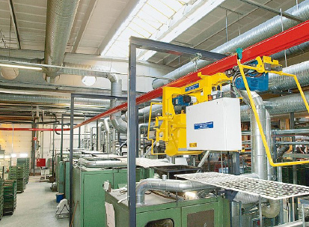
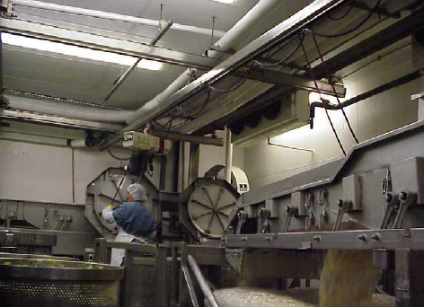
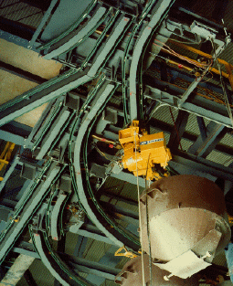
Selected case studies - Monorails
Sand distribution application
Monorail reduces maintenance and increases safety in medical supply lab
Hot metal carrying system for auto-pouring operation
Tire manufacturer improves productivity
Stainless steel rail in food plant
Aerospace company solves die handling problem

Slide 19
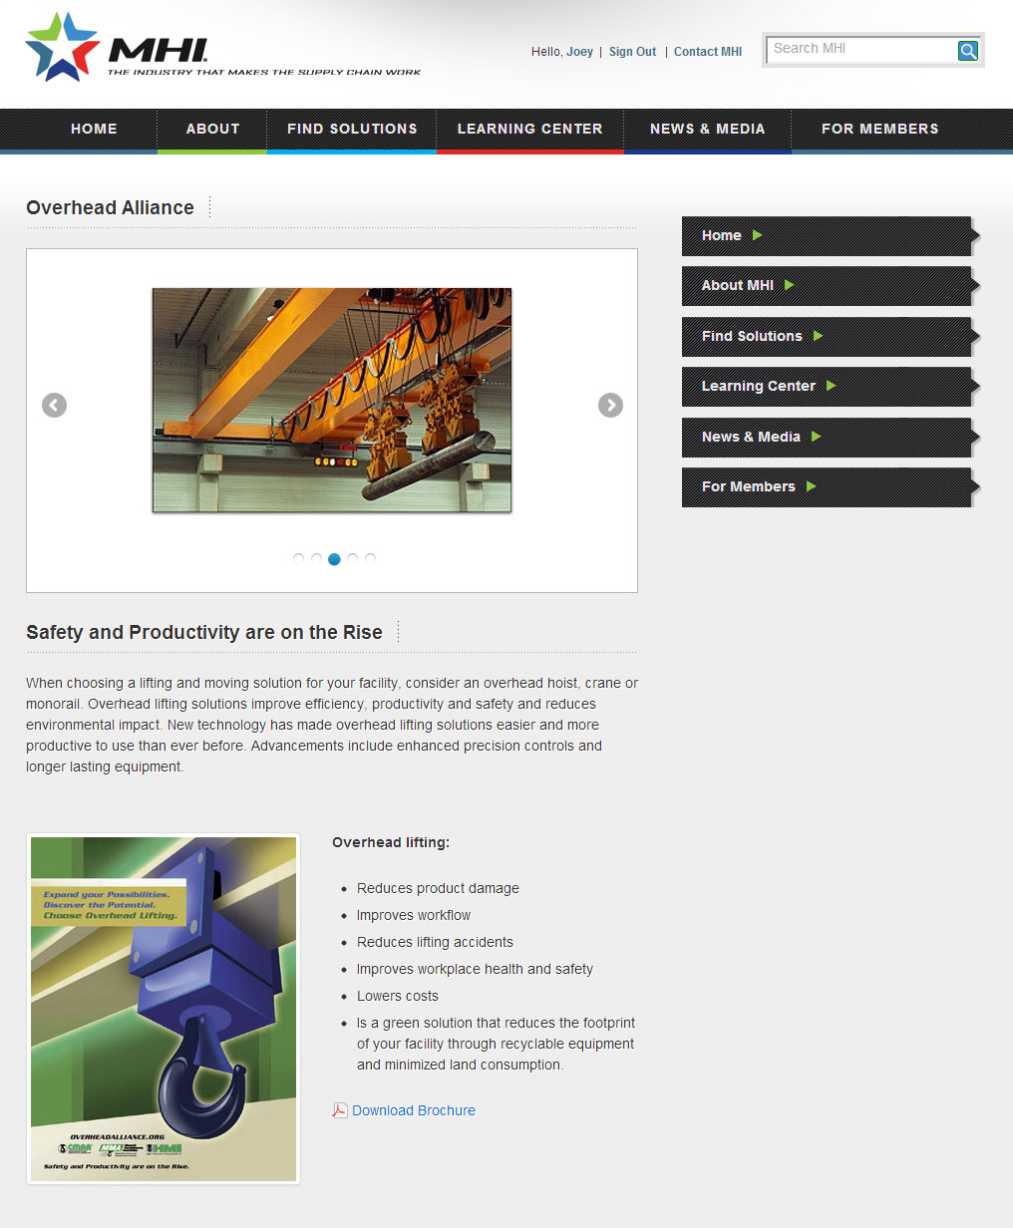
www.overheadalliance.org

Slide 20
CMAA
The Crane Manufacturers Association of America (CMAA) is an independent trade association incorporated in 1955. Member Companies, representing the industry leaders in the overhead crane industry, serve the US market from operations based in the United States, Canada, and Mexico. CMAA is recognized as the leading authority and the principal resource in the overhead traveling crane industry.
CMAA serves the overhead material handling industry through:
Safety Advocacy
Engineering Specifications and Standards Development
Educational Materials

Slide 21
HMI
The Hoist Manufacturers Institute (HMI) members are the Industry’s leading suppliers of hoisting equipment including hand chain hoists, ratchet lever hoists, trolleys, air chain hoist, air wire rope hoists, electric chain hoists, and electric wire manufacturing and distribution sector. HMI operates through committees with programs and policies reviewed and adopted by the membership with representation from each member company. Its many activities include an active engineering committee. HMI is represented on a number of standards developing committees and actively supports the development and certification of safety standards by the ANSI consensus method.

Slide 22
MMA
The Monorail Manufacturers Association, Inc. (MMA) is an independent incorporated trade association affiliated with the Material Handling Industry. MMA Members produce the preponderance of patented and enclosed track underhung cranes and monorail systems. MMA operates through committees with programs and policies reviewed and adopted by the membership with representation from each member company. Its many activities include an active engineering committee. MMA is represented on a number of standards developing committees and actively supports the development and certification of safety standards by the ANSI consensus method.

Slide 23
Other Overhead Lifting info sources
Cranes Today Magazine
Hoist Magazine
Industrial Lift and Hoist
OCH Magazine
Material Handling & Logistics Magazine
Modern Materials Handling Magazine

