Slide 1
Introducing The Material Handling Industry

Slide 2
The Material Handling Industry
Every product you’ve ever used, from televisions to tennis shoes, has been manufactured, stored and shipped to you with the help of the material handling industry.

Slide 3
Material handling powers your in-store and e-commerce shopping experience – enabling you to order and quickly receive products how and when you need them.

Slide 4
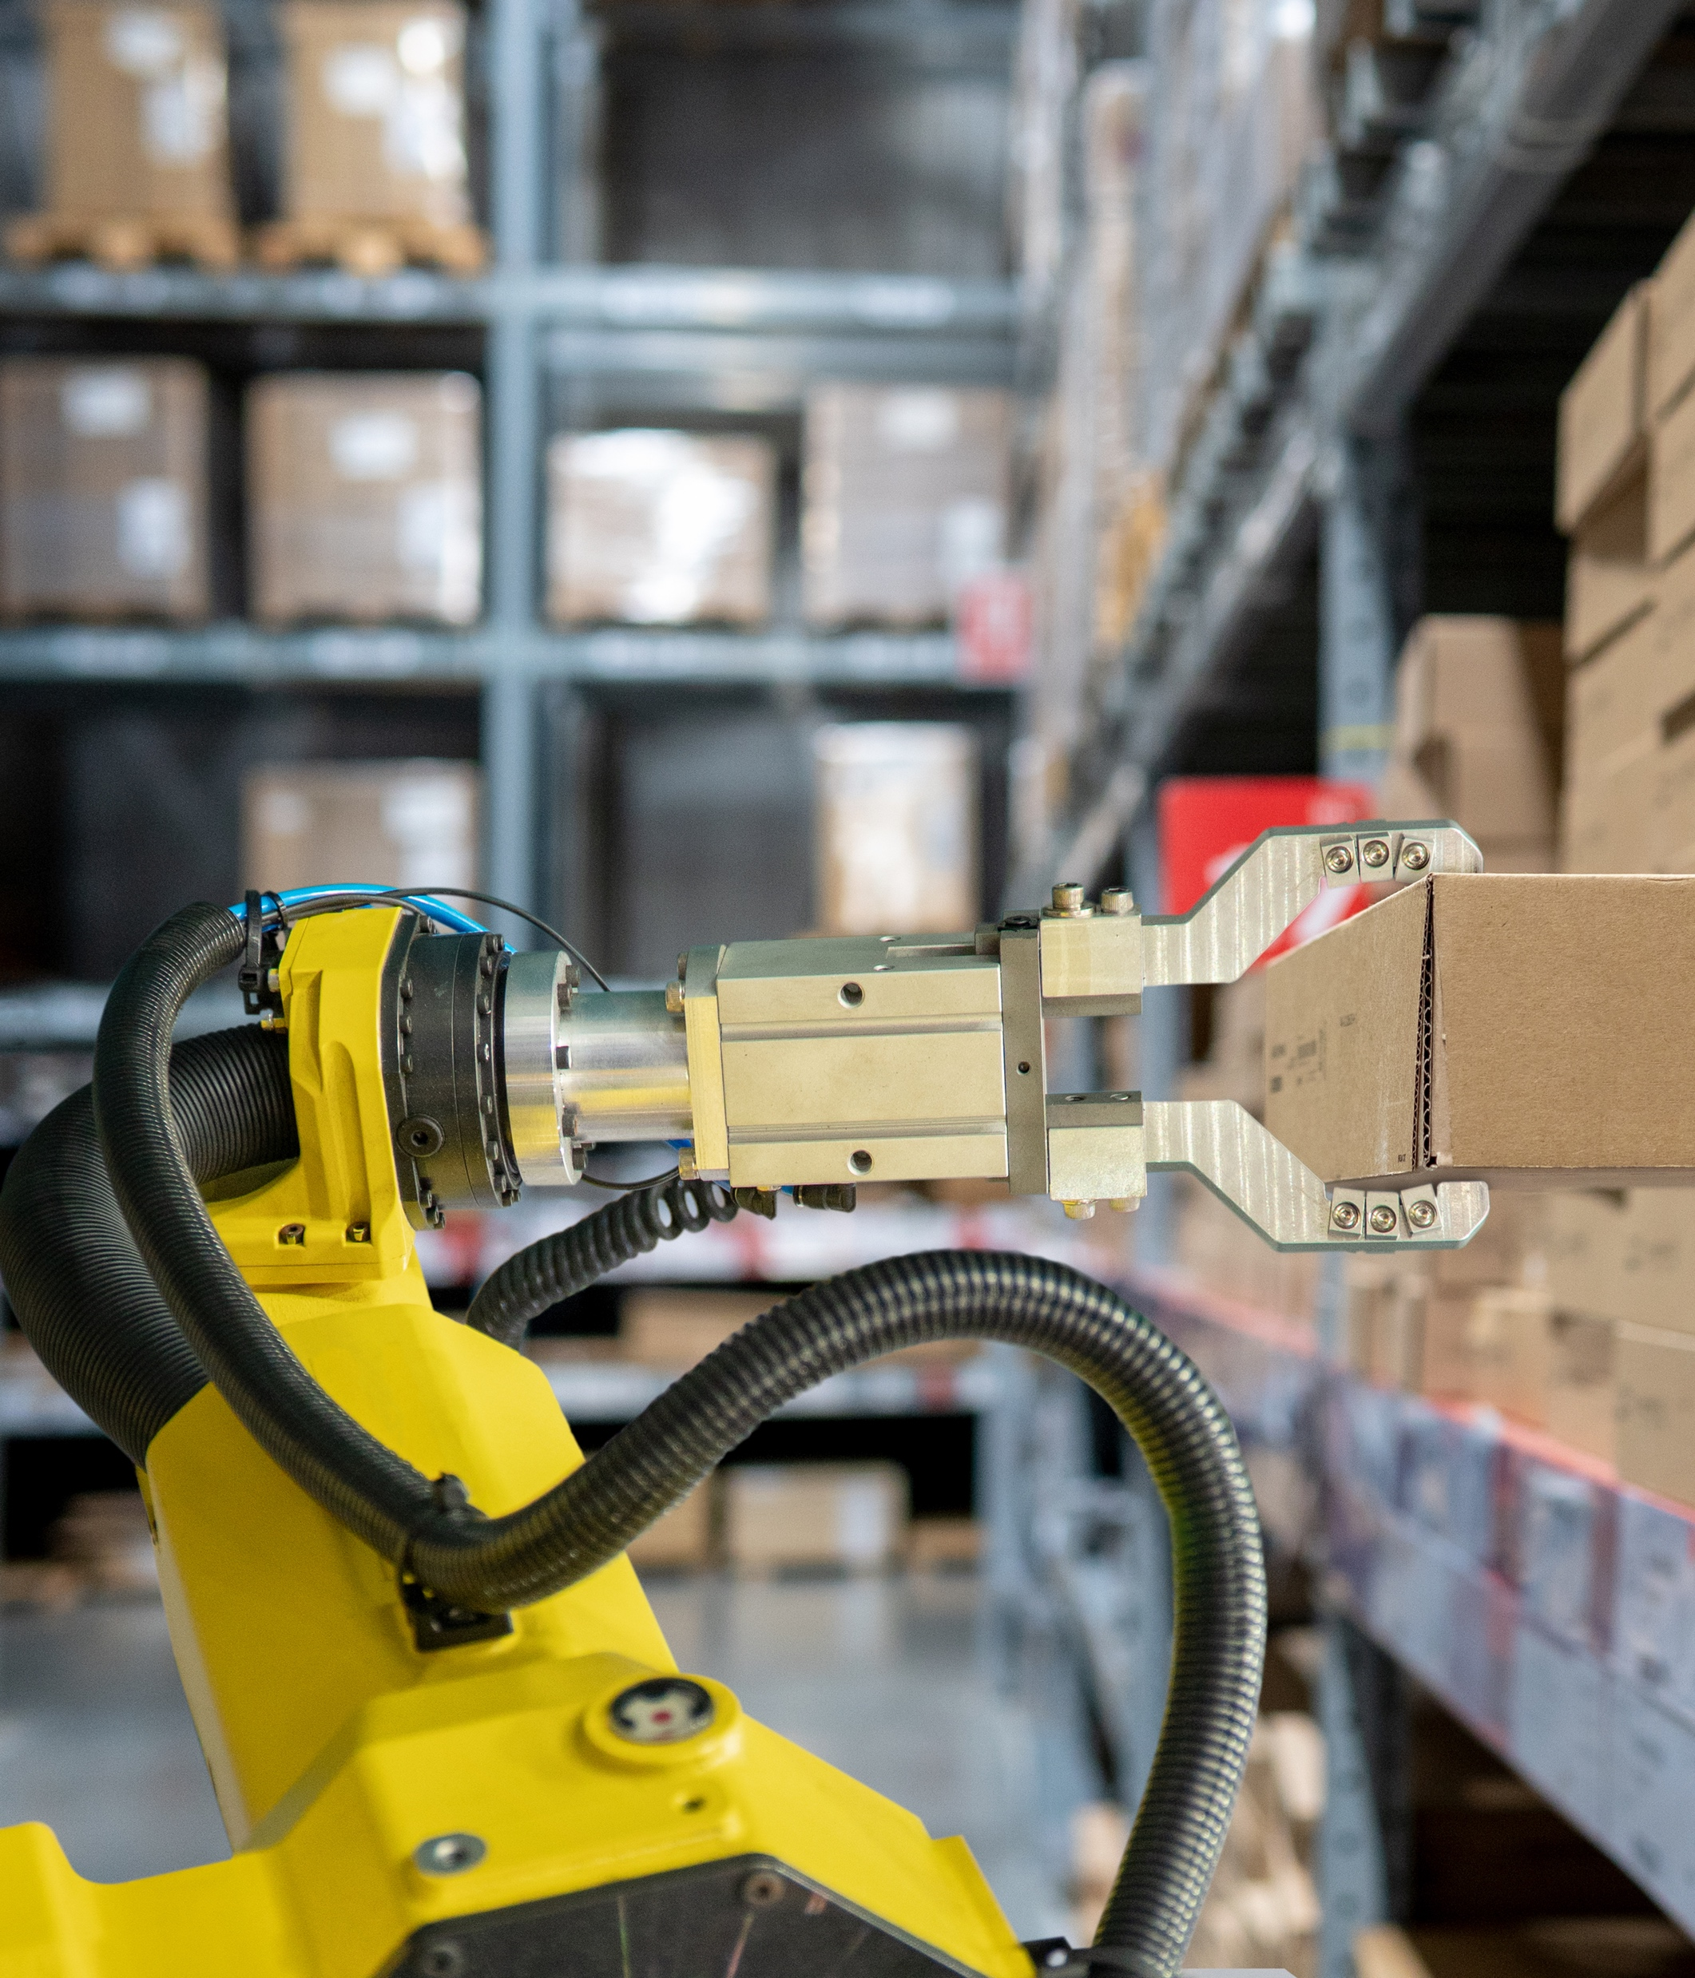
Material handling is the ONLY industry that touches every product as it moves through the global supply chain to the consumer.
The world’s most successful firms use material handling solutions to gain a competitive edge by improving their speed, efficiency and customer experience while maximizing growth and profits.

Slide 5
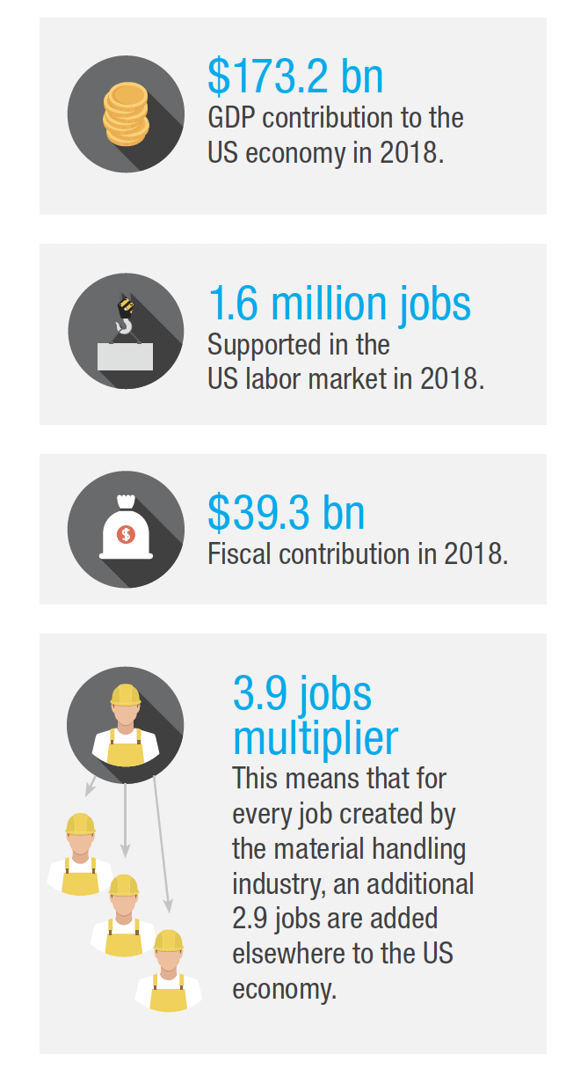
Economic Impact of Material Handling
In the United States alone, material handling is a $173.2 billion industry supporting nearly 1.6 billion jobs.
Despite its size, material handling remains largely unknown as an industry because its work is done behind the scenes of the greater supply chain.

Slide 6
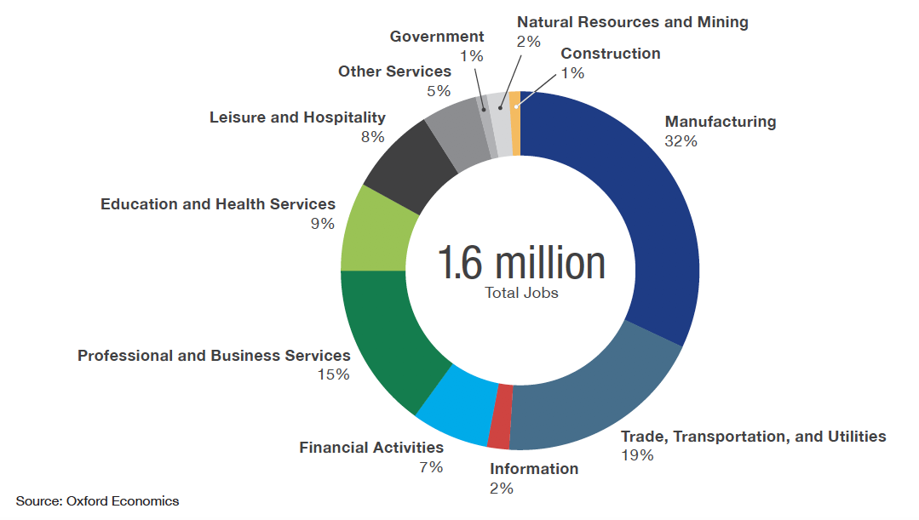
Material Handling Industry Jobs

Slide 7
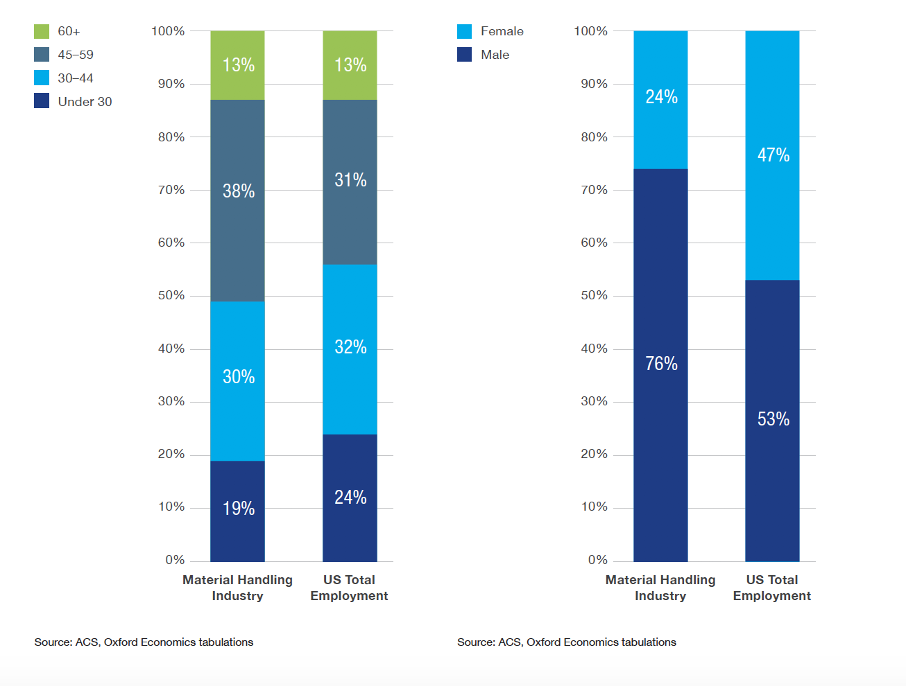
Material Handling Workforce Demographics

Slide 8
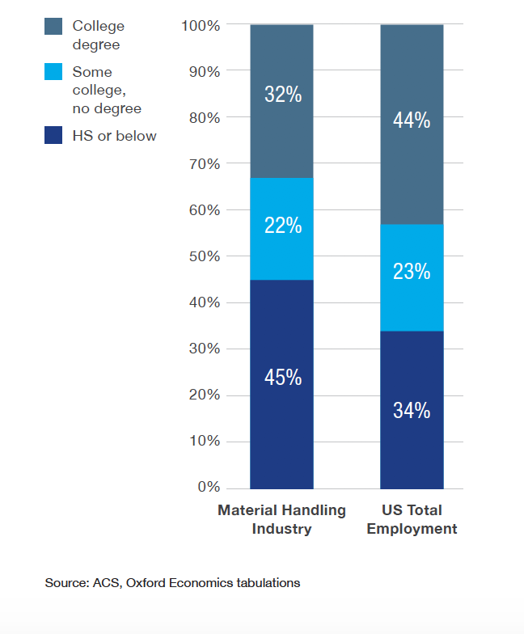
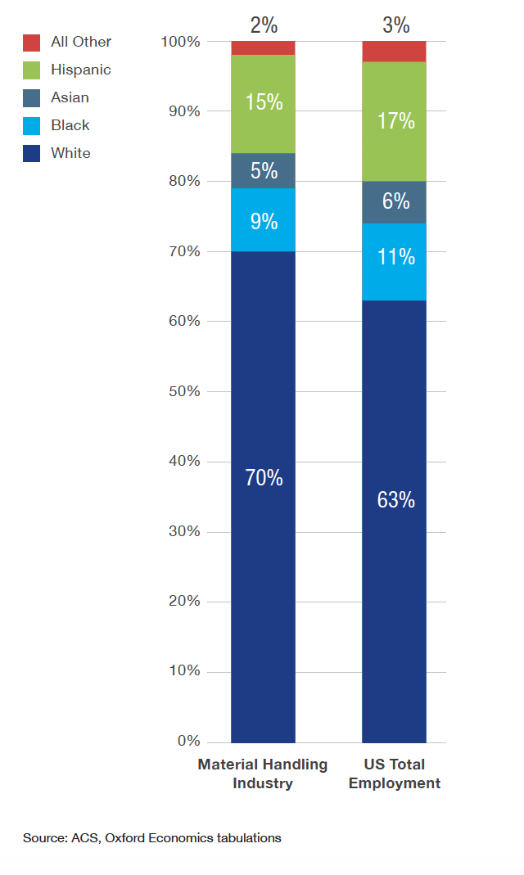

Slide 9
How Material Handling Works
Material handling uses a broad array of equipment, systems, services and expertise to move products through the supply chain such as:
automation, robotics, AI, information technology, automatic identification, lifting equipment, storage equipment, conveying equipment, facilities design and planning, ergonomic and safety equipment, sustainable energy and facility solutions.

Slide 10
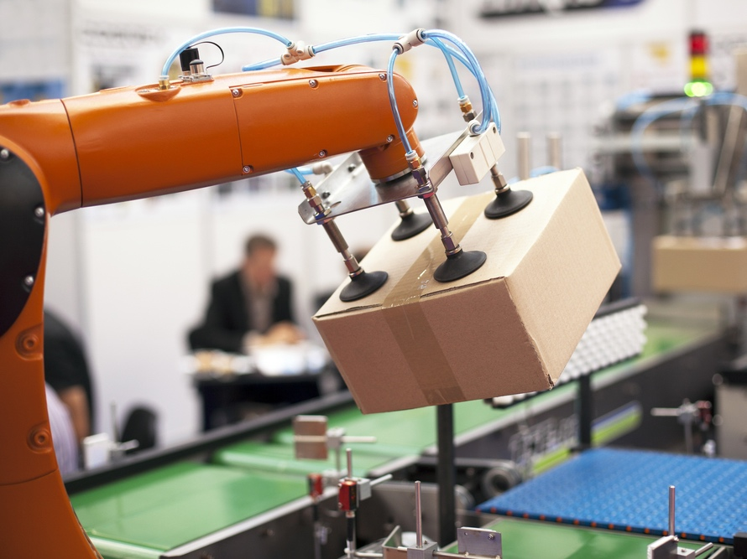

Slide 11
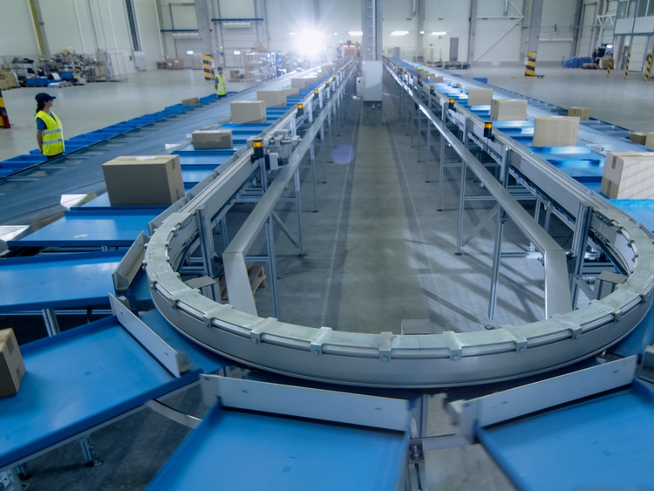

Slide 13
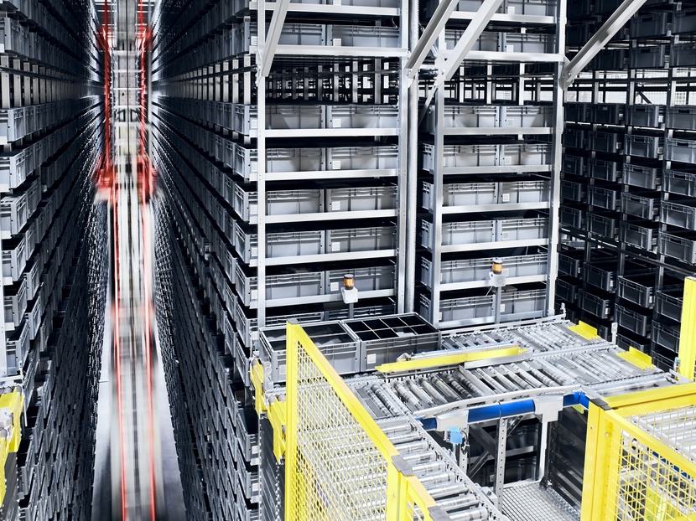

Slide 14
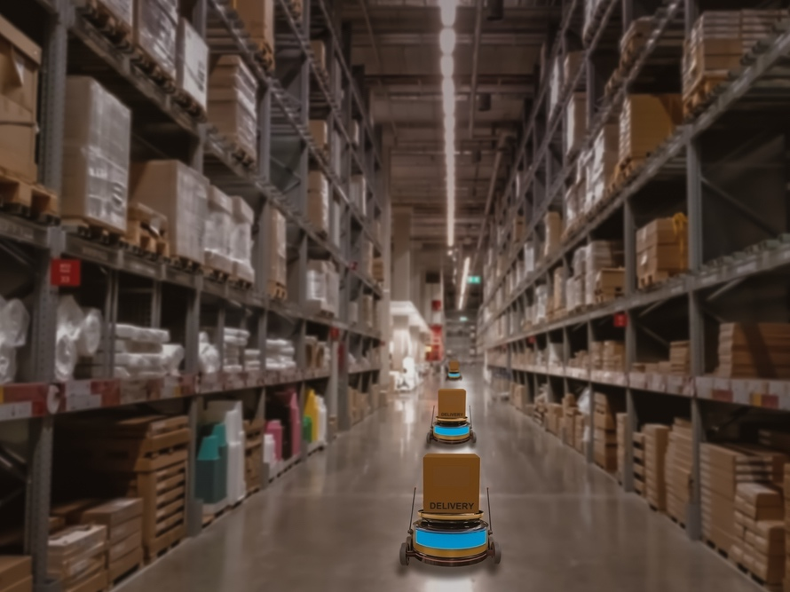

Slide 15
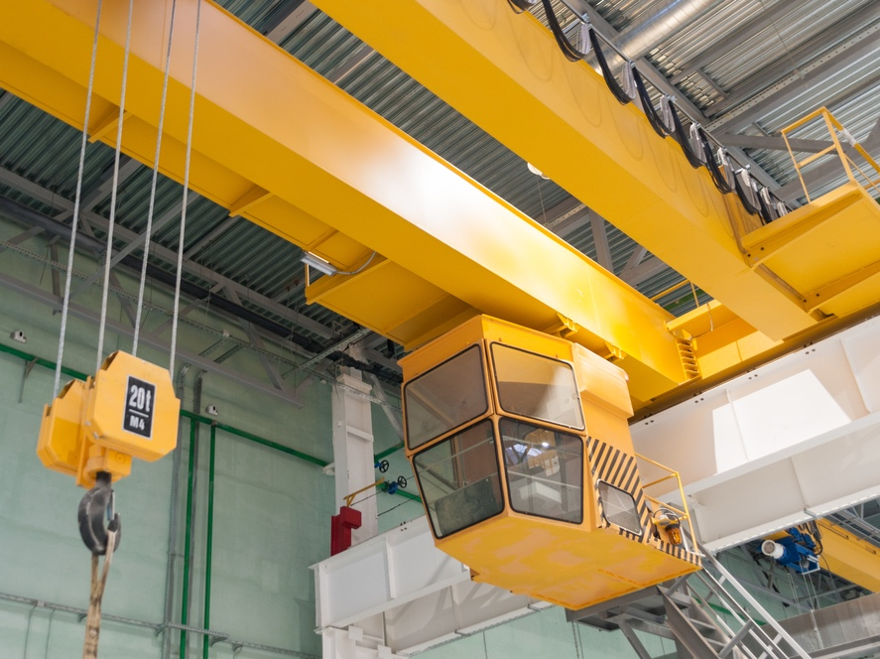

Slide 16
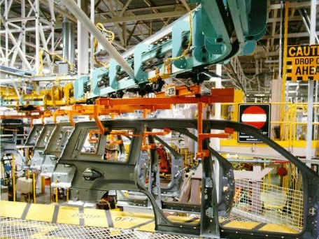

Slide 17
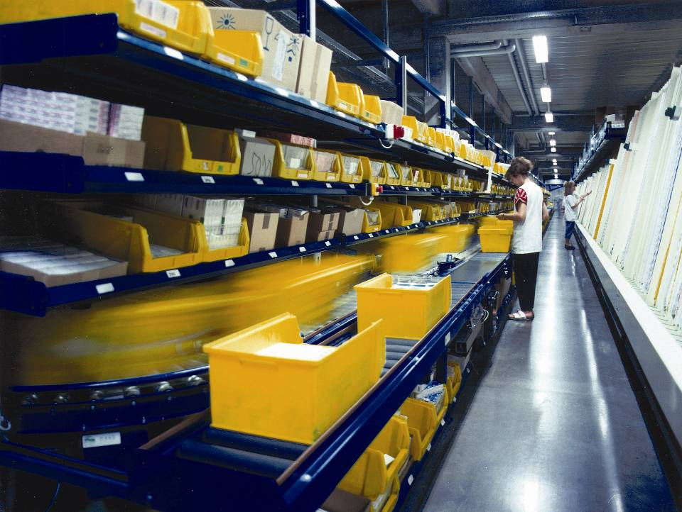

Slide 19
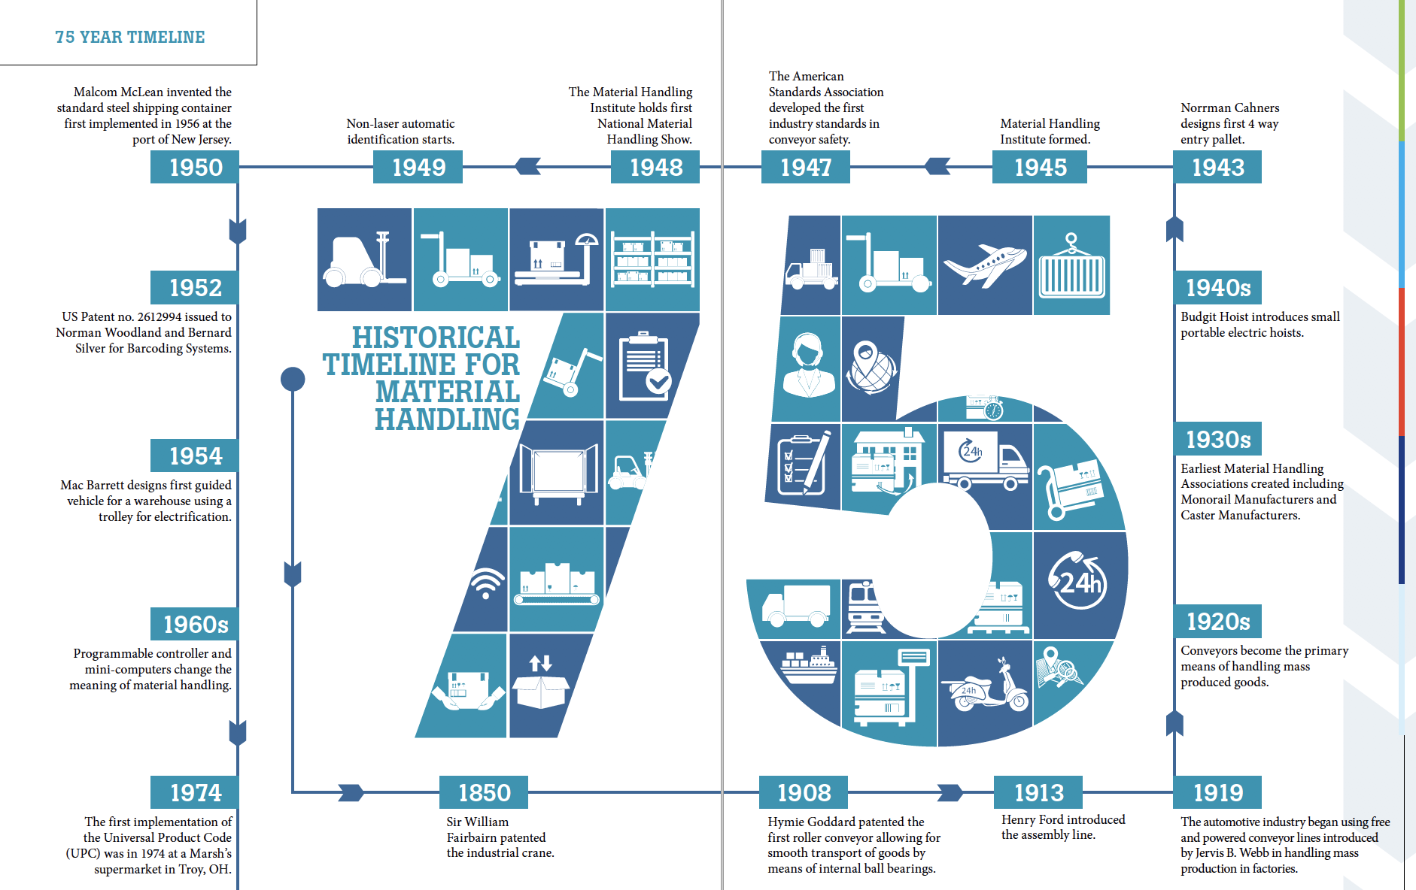

Slide 20
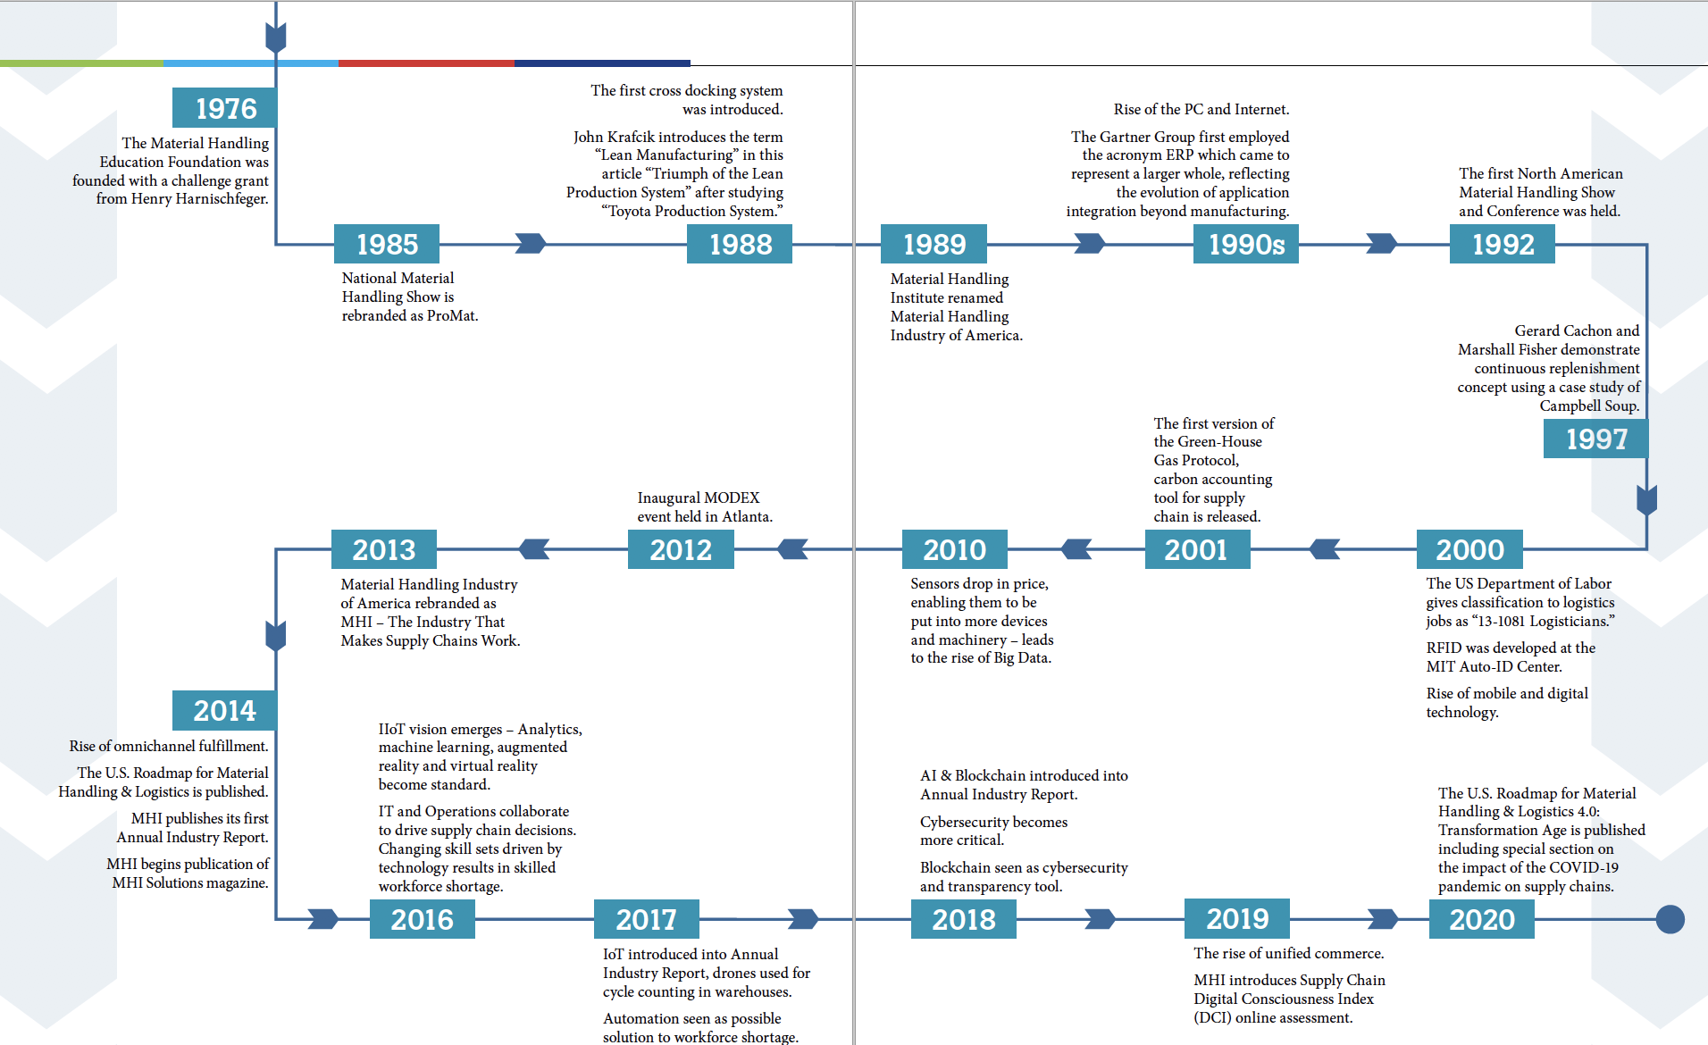

Slide 21
Thousands of career opportunities with competitive compensation and rewarding incentives are available in this exciting industry.
Sales and Marketing
Project Management
Operations Management
Systems Integration
Customer Service
Information Technology
Facility Planning & Design
Human Resources
Finance

Slide 22
Material Handling Industry Informational Videos
https://videos.mhi.org/handling-the-us-economy-the-economic-impact-of-the-material-handling-industry
https://videos.mhi.org/material-handling-as-a-career-path
https://videos.mhi.org/mhi-the-industry-that-makes-supply-chains-work
https://videos.mhi.org/looking-back-on-75-years-of-service

